Slide 1
Employee Data Analysis using Excel
STUDENT NAME : S.REVATHI
REGISTER NO : 2213371036142
DEPARTMENT : B.COM (COMMERCE)
COLLEGE : QUAID -E- MILLATH GOVERNMENT COLLEGE
FOR WOMEN (AUTONOMOUS)

Slide 2
PROJECT TITLE
Employee Performance Analysis using Excel

Slide 3


AGENDA
Problem Statement
Project Overview
End Users
Our Solution and Proposition
Dataset Description
Modelling Approach
Results and Discussion
Conclusion
3/21/2024 Annual Review

Slide 4

PROBLEM STATEMENT
To help the Organisation to evaluate and improve the
employee performance and it helps toidentify the areas
of improvement and growth.
To enhance career development and growth of the
employees by providing training,mentorship and
incentives.
This analysis helps the organization to take strategic
Strategic business decisions by aligning the employee
Performance with organizational objectives.

Slide 5

PROJECT OVERVIEW
To develop a comprehensive data analysis framework to measure employee performance,identify areas for improvement ,and inform data-driven decisions on talent development,resource allocation and strategic business planning

Slide 6

WHO ARE THE END USERS?
Employer
Organization
IT Sectors
Industries
Team leads
Department managers
Data Scientists

Slide 7

OUR SOLUTION AND ITS VALUE PROPOSITION
Conditional Formating - To Highlight the missing values
Filtering - To remove the missing values
Formula - To calculate the performance
level of the employee
Pivot Table - To summarize the data
Graph - Data visualization

Slide 8
Dataset Description
Employee Dataset – Kaggle
9- features
Employee ID - Numerical Value
Name - Text
Employee type - Full time/part time/contract
Performance Level - Very high/High/Medium/Low
Gender - Male/female
Employee Rating - Numerical value
Employee Status - Active/Voluntarily terminated/Future start
Business Unit - BPC/CCDR/EW/MSC/NEL/PL/PYZ/SVG/TNS/WBL

Slide 9

THE "WOW" IN OUR SOLUTION
=IF(Z8>=5, "VERY HIGH", IF(Z8>=4, "HIGH", IF(Z8>=3, "MEDIUM", "LOW")))
3/21/2024 Annual Review
9

Slide 10
MODELLING
Data collection
(i) Raw data from Kaggle
(ii) Analysing it through Excel
Feature collection
(i) Looking it thorugh Pivot table &
overview the results by applying
formulae
(ii) Formulae enhances to get the
result for their individual act
Data cleaning
(i) Sort out the unnecessary data
by filtering option.
(ii) Taking out considered data by
Pivot able.
10

Slide 11
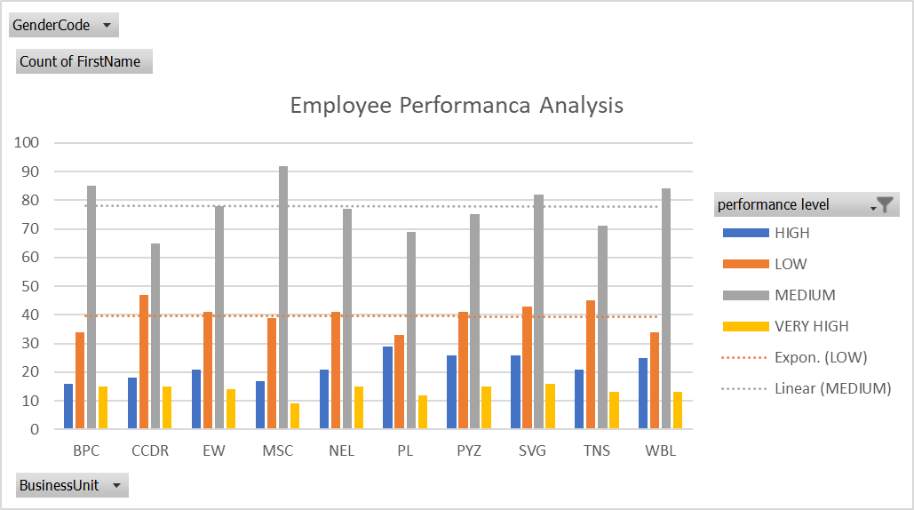
RESULTS
11

Slide 12
conclusion
As far, We had conclude the Employee performance thorugh these results.
A performance evaluation conclusion should briefly summarize a person's performance during the review period, highlighting their key strengths and something they can improve upon: John consistently exceeds expectations and is always willing to help others

